Slide 1
Cloud Computing
SEWP ZG527

Slide 2
Agenda
Virtualization Techniques and Types
Introduction to Virtualization
Use & demerits of Virtualization
Types of Virtualization
- Examples
x86 Hardware Virtualization
2

Slide 3
Technology made cloud possible
Key Technology is Virtualization
App
App
App
App
App
App
OS
OS
OS
Operating System
Hypervisor
Hardware
Hardware
Traditional Stack
Virtualized Stack
Virtualization plays an important role as an enabling technology for datacentre implementation by abstracting compute, network, and storage service platforms from the underlying physical hardware
Notes:
RL 2.1
Virtualization is simulating a hardware platform, operating system, storage device or network resources

Slide 4
Importance of Virtualization in
Cloud Computing
Cloud can exist without Virtualization, although it will be difficult and inefficient.
Cloud makes notion of “Pay for what you use”, “infinite availability- use as much you want”.
These notions are practical only if we have
lot of flexibility
efficiency in the back-end.
This efficiency is readily available in Virtualized Environments and Machines

Slide 5
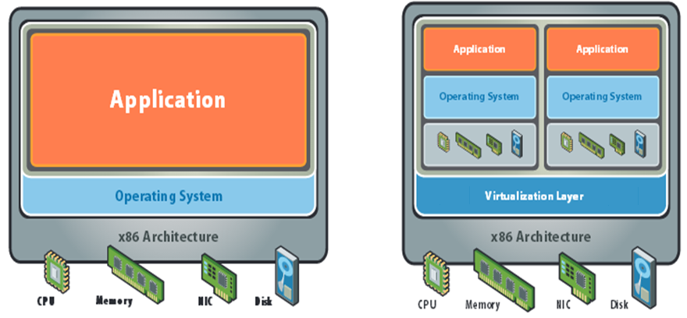
What is Virtualization

Slide 6
What does Virtualization do?
Virtualization allows multiple operating system instances to run concurrently on a single computer
It is a means of separating hardware from a single operating system.
Each “guest” OS is managed by a Virtual Machine Monitor (VMM), also known as a hypervisor.
Because the virtualization system sits between the guest and the hardware, it can control the guests’ use of CPU, memory, and storage, even allowing a guest OS to migrate from one machine to another.
Instead of purchasing and maintaining an entire computer for one application, each application can be given its own operating system, and all those operating systems can reside on a single piece of hardware.
Virtualization allows an operator to control a guest operating system’s use of CPU, memory, storage, and other resources, so each guest receives only the resources that it needs.

Slide 7
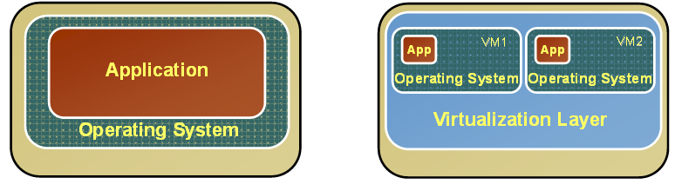
Changes after Virtualization
Before Virtualization
After Virtualization
Single OS image per machine
Software and hardware tightly coupled
Running multiple applications on same machine often creates conflict
Underutilized resources
Inflexible and costly infrastructure
• Hardware-independence of operating system and applications
• Virtual machines can be provisioned to any system
• Can manage OS and application as a single unit by encapsulating them into virtual machines

Slide 8
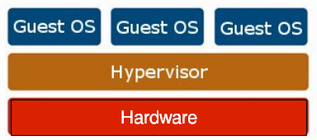
Virtualization Architecture
OS assumes complete control of the underlying hardware.
Virtualization architecture provides this illusion through a hypervisor/VMM.
Hypervisor/VMM is a software layer which:
Allows multiple Guest OS (Virtual Machines) to run simultaneously on a single physical host
Provides hardware abstraction to the running Guest OSs and efficiently multiplexes underlying hardware resources

